Slide 1

Whitfield Urban Expansion
Community Forum
Dover District Council
21st July 2026
6pm

Slide 2
Terms of Reference
Purpose – To facilitate communication between DDC, the developers and the community; act as a critical friend in shaping the Whitfield Urban Expansion.
Objectives – To promote transparency, stewardship, sustainable development and inclusive engagement.
Role – To advise. Recommendations are noted in the minutes, made public and relayed to the developer.
Community
Development
Notes:
SP:
Value added, examples from elsewhere (Cambridge in particular), thinking outside the box, adding more voices and ideas. Fluidity and flexibility added by your own experience and expertise. ToR can adapt to needs over time.
Firstly – some people have a lot of knowledge of planning and others will have less understanding – the presentation hopefully strikes the right balance to assist everyone, but if we slip into terminology or acronyms that you don’t understand, please say!
LB:
The Forum will perform the role of a feedback loop between the community, the local planning authority and the developer to ensure that the voice of the community is heard. This function is in addition to the more formal consultation which will need to take place as part of the masterplan and planning application process. Information can be shared with the community in an active way and issues can be discussed. The Forum will be able to ask questions and make their feelings known, with comments and recommendations being sent to the developers to help them inform their proposals.
The Forum represents a broad range of people who represent Whitfield. Whilst your individual areas of expertise are welcomed, you’ve been chosen as local leaders rather than just your role in representing your organisation, members are also local leaders who can work for the whole of Whitfield and offer views beyond your organisation . These wider views are the focus of the forum.
The information from Forum meetings will be publicly available. Information will be shared, minutes will be sent to members and uploaded to the council’s website and shared with the developers. Outside of Forum meetings, members may wish to discuss the information provided and seek the views of the other residents, members of their groups or the wider community. The Forum will be a transparent conduit for broad range of views across the community, so that local voices are heard as the proposals are drawn up by the developers.

Slide 3
Meeting frequency and arrangements
Meeting frequency
Additional meetings can be agreed by consensus
Independent Chair
Typically at DDC
Agenda and Minutes
Developer attendance (not a member)
Initial focus on informing the development coming forward
What do Forum members want from the Forum?
Agenda
Minutes
Meeting
Notes:
LB:
There’s a need to balance the frequency of meetings with the commitments of the Forums members, the speed and volume of developments on the case and the organisational requirements for meetings. This is by no means the only way in which the community can and will be involved and we would encourage any individual or group to engage proactively throughout the process through the various events, consultations and communications over the coming years. Exceptionally, it may be necessary to hold additional meetings at key points through the process, for example after a consultation event or once the first application is submitted.
The meetings will be Chaired by Roger, who is both known and trusted by many locally but is independent of the Parish and District Councils and the developers. I’d like to place on record our thanks to Roger for agreeing to take up this important role.
Meetings will typically be held at the council offices as it is central, accessible and has the facilities necessary for meetings. However, an alternative venue may be considered if there is consensus that it would be preferable.
Agendas will be published 7 days before meetings, with minutes distributed within 14 days of meetings. These will usually be distributed via the Secretariat, Alice. These documents will also be made available on the council’s website, to ensure that there is a transparent public record of key actions and outcomes.
Whilst, as a community organisation, the developers are not a member of the Forum, they or a member of their team may be invited to Forum meetings when appropriate to share information and otherwise aid the Forum.
The focus of the Forum will be to promote the needs and aspirations of the community to inform the future phases of the Whitfield Urban Expansion.
What do Forum members want from the Forum? Have we missed something? Sub-group to discuss Phase 1 and report back to next meeting? Can be

Slide 4

Introduction to the Format of Forum Meetings
Standing Items
  Update from the Council
  Thematic discussions
  Community engagement
  Updates from the developer (when present)
Forum led with Council guidance
  The detailed theme of discussions will be defined by the Forum
Notes:
LB:
The choice of a Forum rather than a Committee or other format was intentional. Forums are designed to be a collaborative. It allows for information and updates to be shared; facilitates dialogue; and provides a setting in which feedback and local insight can be explored collectively.
Meetings will be led by the Chair, with a view to making sure that all Forum members are able to contribute and share their ideas and opinions. At the end of meetings, the aim will be for a consensus to have been reached, to allow for a clear outcome to be shared.
The agenda for this first meeting is necessarily different from that for future meetings, as its purpose is to establish the Forum and induct its members. At future meetings, the agenda will focus on providing updates, sharing of information and discussing key topics and themes. Whilst the topics of discussion will need to flow from the information which is available at the time and the stage of the process, the Forum will have a role in shaping the discussion, including what topics are of particular importance to the community.

Slide 5
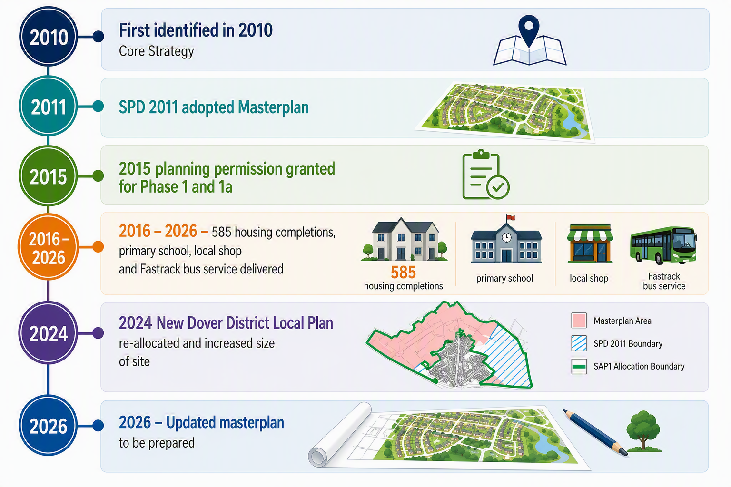
Background to Whitfield Urban Expansion
Notes:
We know that some people in the room will already be fully aware of the background, having been involved in the development since its fruition, but some of you may not be aware of any of the background, so we just wanted to provide a high level summary of the background and history to the site, which has been being planned for more than 15 years, and is likely to continue to develop out over the next 20 years at least.
It was first identified as an area for new development in Core Strategy in 2010. The Core Strategy was at that time what we now call the local plan – which is a plan for the whole District that identifies where new development can be located and sets out policies by which planning applications are assessed against. The Core Strategy identified the Whitfield Urban Expansion to provide around 5,750 homes supported by a range of physical, social and green infrastructure, and other supporting uses such as shops, offices, and community facilities.
The Core Strategy set out the overarching requirements, which was then supplemented by a more detailed Masterplan (WUE SPD). A masterplan sets out a plan for how a large development like this, (which is being developed over many decades and by multiple developers) will be designed, built and function as a complete place, rather than a collection of housing estates. It provides the overall vision and framework for where homes, schools, roads, parks, employment area, community facilities and utilities will go. It brings everything together to ensure that the area grows in a co-ordinated way, and provides the infrastructure and services needed for a successful new community. Planning and delivering a large scale development like this, is complex and requires co-ordination of multiples parties. The WUE masterplan was adopted in 2011.
In 2015 planning permission was granted for the first Phase – which is now being built out.
Permission has also been granted for a separate site on Singledge Lane which is now built out.
There are now over 500 homes built, primary school and local shop open, and the Fastrack bus service implemented.
Local Plans have to be updated on a regular basis to ensure we are always planning for the development needs of the District for 10-15 years in advance. In 2024 we updated our Local Plan which plans for the District until 2040. As part of this more land has been identified at the WUE to provide for an additional 600 homes, and the plan requires an update to the masterplan to take this into account.

Slide 6
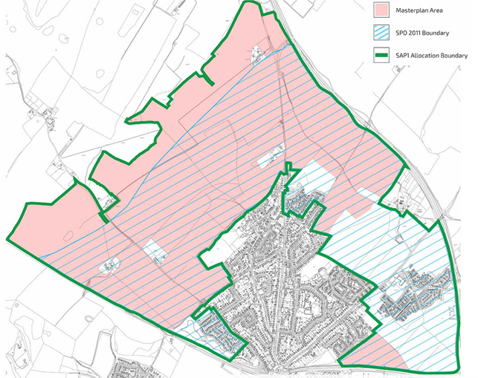
Policy SAP1 and the updated Masterplan
In the region of 6,350 homes, retail, leisure and employment uses, supported by transport, education, health and social care, utility services and green infrastructure
Requires revised masterplan, to set out
  Quantum and distribution of land uses
  Access arrangements
  Sustainable design and layout principles
  Updated phasing and delivery strategy
  Incorporating garden village principles
Masterplan currently being prepared by Persimmon working jointly with the Council and other stakeholders
Masterplan will be subject to full public consultation before being adopted by the Council
Notes:
Policy SAP1 is the specific policy in the Local Plan that covers WUE and which planning applications for the site will be considered against. Policy SAP1 included the overarching requirements for the development and what the updated masterplan should cover.
This plan shows the original site boundary – blue hatching
The green line is the area that the new Local Plan Policy SAP1 covers
The pink area shows the land that will be included in the updated masterplan – which is all land in the whole WUE boundary that doesn’t already have planning permission/is not subject to current applications.
Development of the updated masterplan is the next step, and this is likely to be closely followed by planning applications for the site.
Persimmon are the developer with control over the majority of land in the masterplan area, so are leading on the masterplan development working jointly with the Council and other stakeholders.
The Masterplan is a high-level document which sets the parameters for the development – it sets the scene of the constraints and opportunities for the development, will establish the principles and the vision which will guide future applications and provide a strategy for delivering the requirements of the policy and will consider aspects such as potential routes for Fastrack and key roads, the locations of schools and the locations for community facilities. High level indicative plan, that won’t necessarily identify specific locations and needs to be flexible enough to acknowledge that the development will be coming forward over a long period of time.
The masterplan will be subject to a full public consultation later this year before being agreed by the Council.
We are being supported by ATLAS – who are in independent organisation funded by government to provide advice and support in bringing forward large scale developments like this. They bring in a variety of expertise and experience and lessons learnt from developments across the country. We are really pleased with to have their support, as this development is really important to the Council
Really important for us – not just a housing development – aim for it to be an exemplar developments. Been set up internally as a project, thinking collaboratively.
Developer led scheme – there will be issues and areas where we don’t agree, and can’t achieve everything that we might want to achieve, but we are really ambitious to make this a success, including learning lessons from the past.

Slide 7
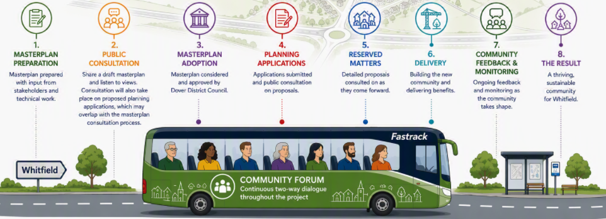
Community Engagement and Communication
Ward Members, Parish Council, Community Forum, Public Consultation
Notes:
LB:
The Community Forum will be a vital tool to ensure on going communication between the Council and the community. Whilst there will also be ongoing engagement with ward members and the Parish Council, and targeted public consultations ahead of key decisions, the community forum will provide for regular, open discussion throughout the process, from consideration of the Masterplan to monitoring the build out and compliance with conditions.
There are lots of different stages where your community can be involved in the planning process.
Masterplan first, most likely followed by applications. Proactive rather than reactive. Formal channels too, this is the additional measure to prepare you.
Agenda item for feedback from you community groups. What can they be doing proactively. You can go away with actions and things to do as well as us. Examples of good community forums have added – temporary uses, asking the developer to things informally.
As discussed, the forum meetings will provide a continuous means to two-way communication. A public webpage will be made available on the council's website which will host key documents, agendas and minutes from these meetings and other important information for the Whitfield Urban Expansion, enabling the wider community to keep up to date with progress and consultations. The Forum doesn’t detract from the developer obligations and the normal consultations which applications require.
It’s important to provide the right comments at the right point in the process. At the Masterplan Stage, the most valuable comments are those which address strategic issues. As set out, an updated Masterplan is being prepared. There will be formal consultation on the draft document later in the year, which will run for 28 days. As you will see from the agenda, we will be seeking views on Core Values later in the agenda.
Whilst the focus at the moment is the Masterplan, I can briefly run through the future stages of the planning process, so members can understand the various points at which there can be further involvement regarding more detailed matters.
Once a Masterplan has been agreed, the next stage is for planning applications to be submitted.
How applications are submitted and what form can be technical, and we would be happy to present this at a further meeting; however, all types of application will be the subject of formal public consultation and will, no doubt, be discussed in detail at future Community Forum meetings.
Each planning permission will be subject to conditions, which control how the development takes place. The inclusion of conditions and their precise wording is important in making sure the development takes place as envisaged. If the development deviates from the planning permission or its conditions, the council are able to raise this with the developer and, ultimately, can consider formal enforcement action.

Slide 8
Discussion on Placemaking Principles (Core Values)
Follows on from Stakeholder Workshops
Centred on what is valued by the community
Ensuring the priorities of locals are heard
What is most important to you?
What is special about Whitfield?
What would the community benefit from most?
Accessible for all
Climate resilient
Contextual
Engaged communities
Equitable
Genuinely affordable
Identity
Inclusive
Landscape-led
Nature
Public spaces
Stewardship
Vibrant
Notes:
The policy for the site (SAP1) sets the broad parameters of what the allocation will deliver and establishes a set of requirements for any development proposals. It’s intended that the development follows Garden Village principles, supporting amongst other things healthy living, a socially vibrant place, walkability and community stewardship. Some of you may have been involved with the Local Plan, which is where these matters were discussed. However, what the policy can’t do is establish what is most important to the people who live and work in the community and what makes Whitfield special.
Workshops have already taken place with some of the key stakeholders, to understand what needs to be built upon and what needs to be added, but the Forum as a collective has a unique insight into what Whitfield is and what it can be, so understanding what you value most is really important.
You have a list of suggested principles, which will all feed into the masterplan, but we would welcome your views as to the most important things for the community.
There’s a lot of guidance about what makes new development function well. These ideas, together with some of the outcomes of the Workshops have been distilled in the list you can see on screen. Thinking about what is important to you, what makes Whitfield special and what would the community benefit most from, which of the ideas do you think are most relevant or most important? Has something really important been missed? Particularly as this is the first meeting, and some people may be less inclined to offer their views, we thought it might be useful to provide you all with a list of the suggested Core Values for you to rank – perhaps your top 5 with 1 being the most important. Equally, if there is a core value which isn’t on the list, there is space for you to add this at the bottom of the sheet. There’s also space for you to add a commentary on why you’ve chosen a particularly value or to explain in more details if you would wish. We can then collate your thoughts and suggest a set of the most important Core Values for the development to be fed back to the master developer as a steer from the community.
Are there any other key issues that can be fed back to the Masterplan? Does anybody want to start the conversation?

Slide 9
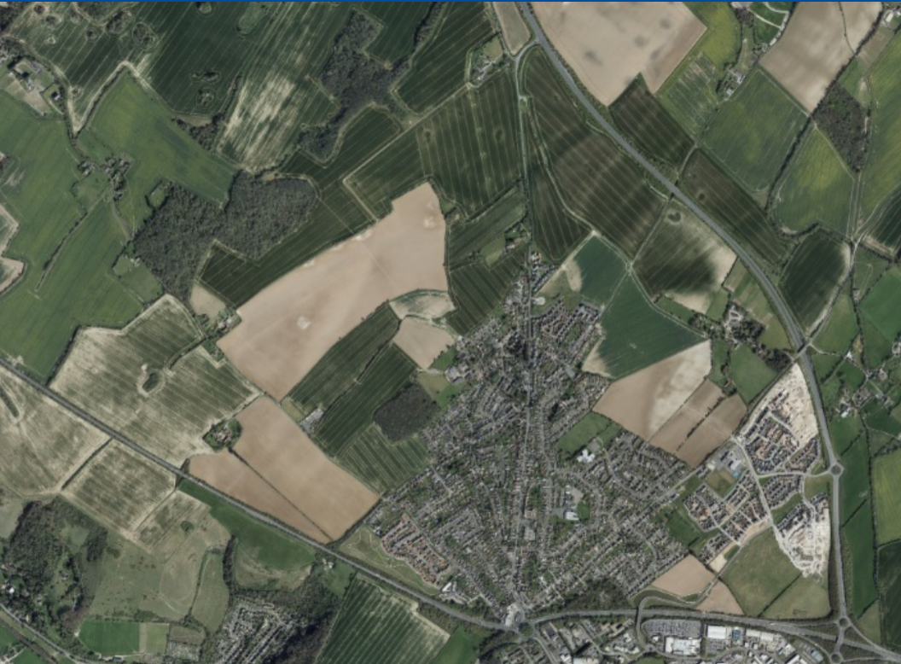
Notes:
Added this in case it’s helpful to orientate the Forum
Not just housing – community.

